Slide 1


Software Quality Management (SQM) & Software Quality Assurance (SQA) systems for IT/SW/CIS development industry
Team_09
Alaaddin Elballa
Anand Reddy Sripathi

Slide 2
Table of Contents
Index | Title | Slide Number
1 | Introduction | 3 – 5
2 | (SQM) & (SQA) Top systems analyzed | 6 – 8
3 | Software Engineering Process Model | 9
4 | Scope Management | 10 – 11
5 | Time Management | 12 – 16
6 | Resource Management | 17 – 23
7 | Cost Management | 24 –32
8 | Risk Management | 33 – 40
9 | Procurement Management | 41 – 42
10 | Statement of Work | 43 – 45
11 | References | 45

Slide 3
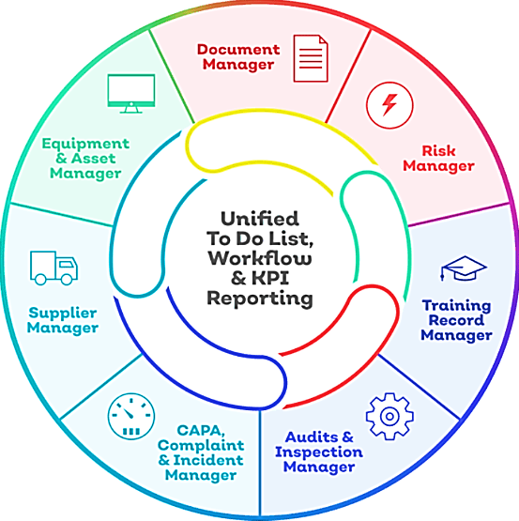
Introduction
[1] [2]
A Quality Management System (QMS) is a set of:
Policies
Processes
Procedures
required for planning and execution (production/development/service) in the core business area of an organization.
A process based QMS enables the organizations to:
Identify → Measure → Control → Improve the various core business processes that will ultimately lead to improved business performance.
Notes:
(general information about project, client/customer (if any), systems’ domain, etc.)
3 Slides

Slide 4
Introduction
[3]
SQM Activities
Quality Assurance
Quality Planning
Quality Control
Software Quality Management (SQM) is a type of management process or procedure that aims to develop and manage the quality of software.
The goal is to ensure that the product meets the quality standard assumed by the customer while also meeting any necessary regulatory and developer requirements.
The software is required to be tested by software quality managers before it is released to the market.

Slide 5
Introduction
[4]
Post Development
Development
Prior to Development
Software Quality Assurance (SQA) is a set of activities to ensure desired quality in software engineering process.
It is a procedure of monitoring all the methods and activities of software development life cycle (SDLC).
Software Assurance Control (SQC) is a method of maintaining and achieving the quality standards in Software Products with the assistance of testing against the predefined, standard specification.
SQC is a reactive and corrective procedure through which an undeveloped product grows into the end product.
SQC
SQA
SQA

Slide 6
(SQM) & (SQA) Top systems analyzed
[5][6][7]
HP ALM(Quality Center)
TestRail
Selenium
Wercker
Jenkins
New Relic
GitHub
Text Shortcode
Postman
TestingWhiz
Sahi
Ranorex
Notes:
a LIST (a table with name + logo + web address for each system)
1 slide

Slide 7
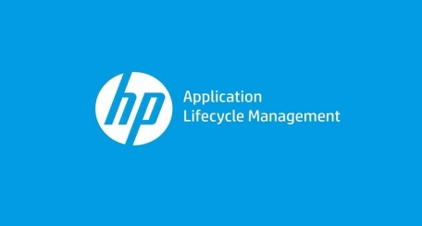





(SQM) & (SQA) Top systems analyzed
[5][6][7]
Scope | A web-based tool that helps organizations to manage the application lifecycle right from project planning, requirements gathering, until Testing & deployment. | A complete web-based test case management solution to efficiently manage, track, and organize your software testing efforts. | An umbrella project for a range of tools and libraries that enable and support the automation of web browsers. | a self-contained, open source automation serve which can be used to automate all sorts of tasks related to building, testing, and delivering or deploying software. | New Relic One is an entity-centric observability platform. For engineering teams with complex environments, it empowers you to find, visualize, and understand everything you need to deliver more perfect software. | Empowers organizations and their development teams to achieve continuous integration and continuous delivery (CI/CD) goals with micro-services and Docker. This is brought to life through its container-centric and cloud-native automation platform comprised of their local command line interface (CLI), online SaaS platform and API.
Main Functions | Release Management Requirement Management Test case Management Test Execution Management Defect Management Reports Management | Automated Testing Functional Testing Exploratory Testing Reporting Projects Tracker | Web applications Automation Web-based Administration tasks automation | Continuous Integration (CI) / Continuous Delivery (CD) | Monitor code & Track transactions Monitor infrastructure & Centralize logs Enhance browser performance, Monitor mobile apps & Simulate user activity Collect data without an agent & Build an app with SDKs Analyze, organize, process, and understand your data. | Continuous Integration (CI) / Continuous Delivery (CD)
Programming Languages | Java 2 Enterprise Edition (J2EE) | JavaScript UI Script | Java Script Java C# | Java Script Java XML | Ruby | Python Shell Script
TLOC | - | - | 695K | 1.04M | 70.9K | 5K
Technical Platform | Version 15.0.x Microsoft Windows 10 64 Bit Microsoft Internet Explorer 11 Microsoft Office 2016 32 Bit | Windows, Linux OS Internet Explorer 11 & Edge Firefox Chrome, Safari, Webkit | Chrome, Mozilla Firefox Internet Explorer Opera Safari | Hardware:1 GB+ of RAM, 50 GB+ of drive space Software: Java 8 runtime environments Chrome,Mozilla Firefox Internet Explorer, Safari | Chrome, Mozilla Firefox Internet Explorer Opera Safari | Mac, Linux OS
Website | [8] | [9] | [10] | [11] | [12] | [13]
Notes:
a TABLE with OUTCOMES of COMPARATIVE ANALYSIS (a table with main data about 10 designated top systems (scope, main functions, main programming languages used in code, lines of code (LOC) based estimation, Function Points-based estimate – OPTIONAL, historic data based estimation (from analyzed 10 top systems in that domain, technical platforms required by those systems )
1-2 Slides

Slide 8






(SQM) & (SQA) Top systems analyzed
[5][6][7]
Scope | Is a website and cloud-based service that helps developers store and manage their code, as well as track and control changes to their code. | Is a terminal multiplexer. It lets you switch easily between several programs in one terminal, detach them (they keep running in the background) and reattach them to a different terminal. | Is a collaboration platform for API development. Postman's features simplify each step of building an API and streamline collaboration so you can create better APIs—faster. | Is a Codeless Automation Testing Tool for Software, Web, Mobile, Database, Cloud, Web Services and API testing. | Is designed to solve the everyday problems faced by the testers. It is uniquely tester-centric in its design and functionality. | It empowers testers with a complete toolset for end-to-end testing of desktop, web and mobile applications in a single license. Automate tests on a Windows desktop, and then execute them locally or remotely, on real iOS or Android mobile devices or on simulators/emulators.
Main Functions | (CI) /(CD) Secure SW Development Code Review Hosting For Code & Documentation Project Management Tools | tmux is a terminal multiplexer: it enables several terminals to be created, accessed, and controlled from a single screen. | API-First Development Application Development Automated Testing Exploratory Testing Developer Onboarding Developer Portals | Regression Testing Web Application Testing Cross-Browser Testing Database Testing Web Services Testing Mobile Application Testing | Simple and Powerful APIs Automatic Waits Object Spy and Recorder Business Friendly Frameworks Automatic Logging and Reporting Parallel and Distributed Playback Continuous Integration | Functional Testing GUI Testing Tools Regression Testing Tools Keyword-Driven Testing Data-Driven Testing
Programming Languages | Java XML XML Schema | C C++ | Java Script | Java Eclipse RCP Groovy Java script | Java Script Java HTML | Microsoft’s .NET platform.
TLOC | 393K | 49.7K | 38.4K | - | 50.5K | -
Technical Platform | Chrome, Mozilla Firefox Internet Explorer Opera Safari | Chrome, Mozilla Firefox Internet Explorer Opera Safari | macOS 10.9. Linux Windows 7 and above | Platforms: Windows XP, 7, 8, 10, Server 2008 & Server 2012 Protocols: Http, Https, FTP, SFTP, SOAP, XML, REST, AJAX & Applets | Internet Explorer 6, Mozilla Firefox 2 Google Chrome 6, Safari 5, Opera 9 and up PhantomJS, Microsoft Edge 25 and up | Processor: 2 GHz dual core, Memory: 1 GB Windows 7 SP1 and up MS Windows Installer 3.1 MS Visual C++ 2017 Microsoft .NET Framework 4.6.2 Internet Explorer 11
Website | [14] | [15] | [16] | [17] | [18] | [19]
Notes:
a TABLE with OUTCOMES of COMPARATIVE ANALYSIS (a table with main data about 10 designated top systems (scope, main functions, main programming languages used in code, lines of code (LOC) based estimation, Function Points-based estimate – OPTIONAL, historic data based estimation (from analyzed 10 top systems in that domain, technical platforms required by those systems )
1-2 Slides

Slide 9
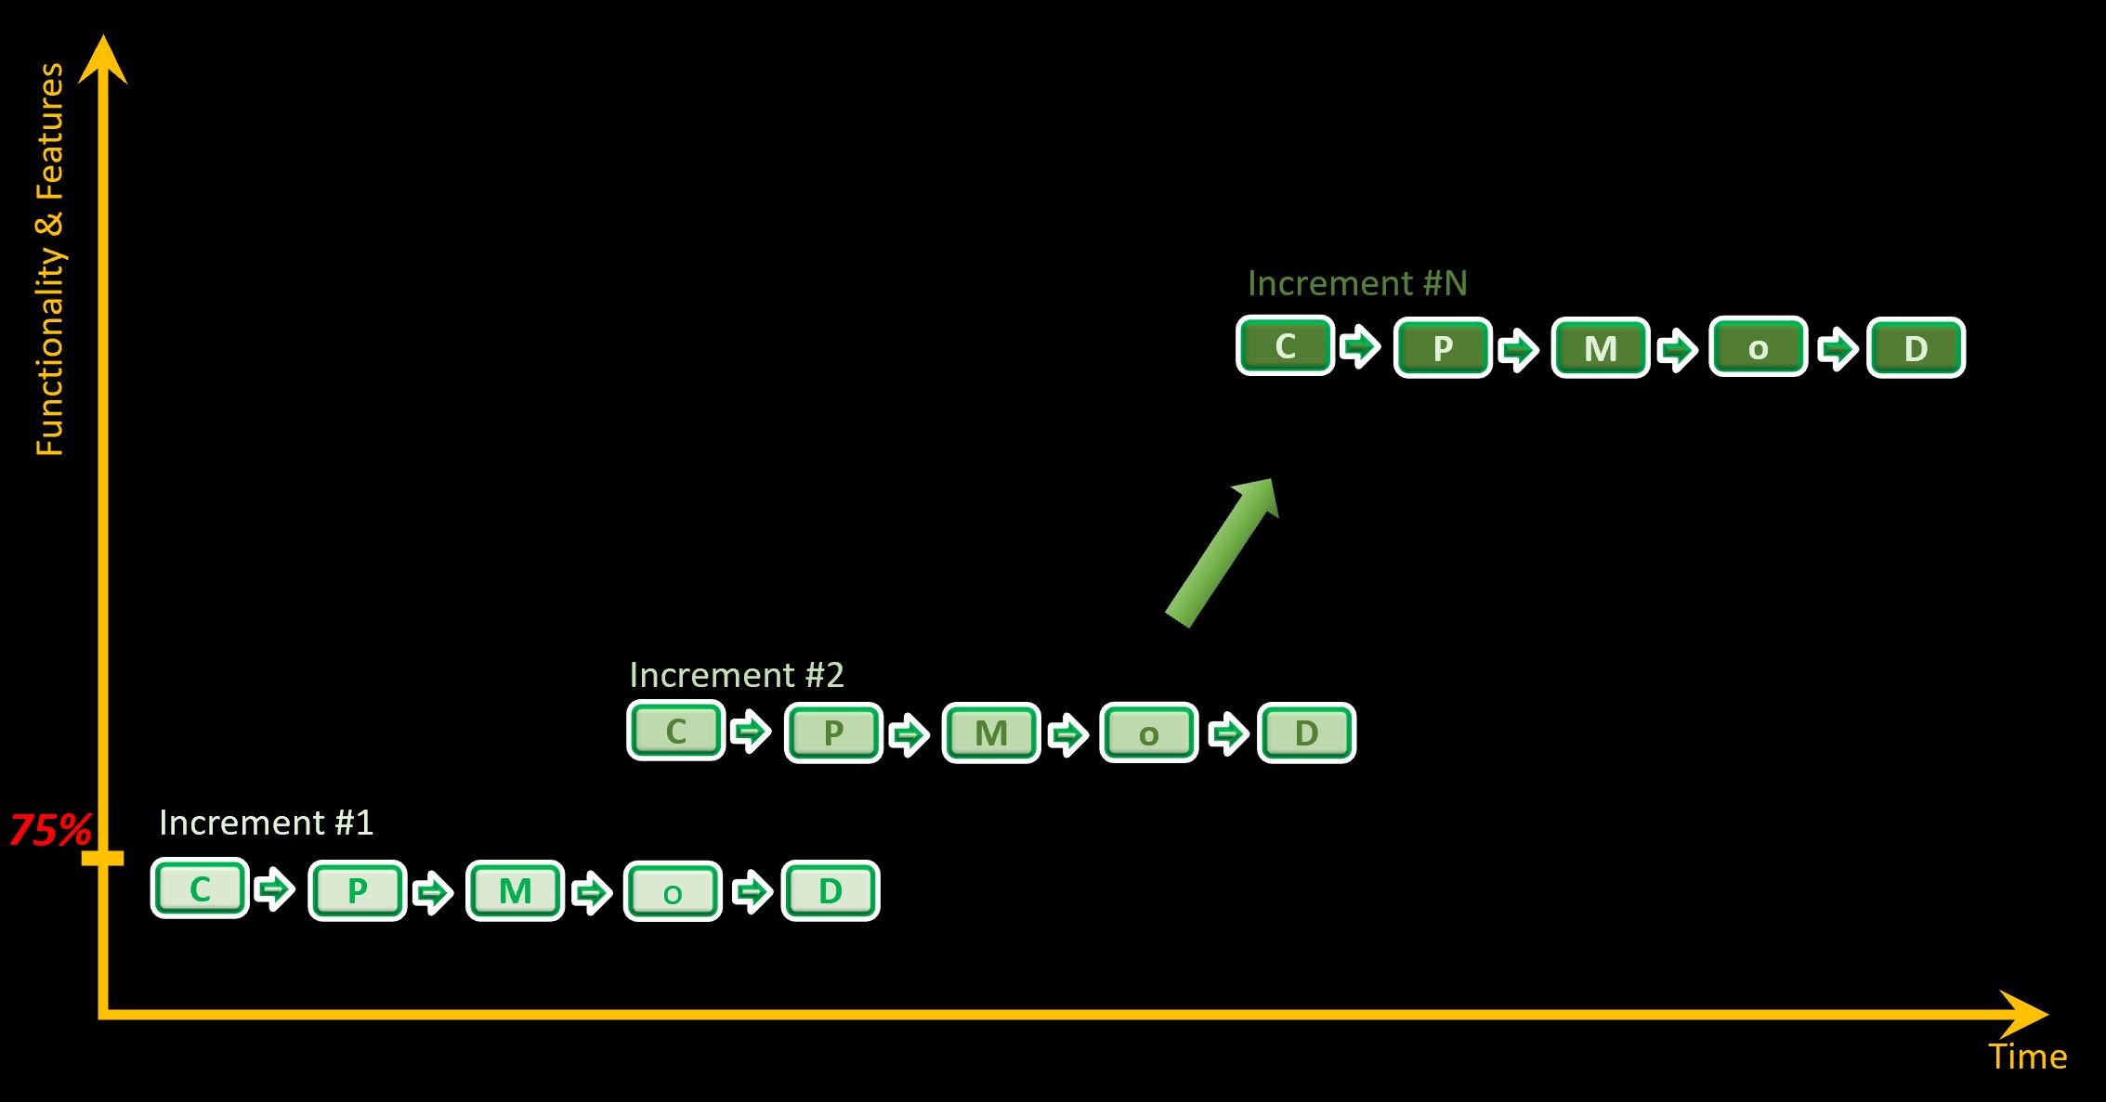
Software Engineering Process Model to Be Used
The Incremental Process Model will be adopted.
SW has a Medium level of complexity.
SW requires average number of developers.
Evolutionary type of SW.
Feedback from customer is required for enhancements.
Customer Might feel the need to add more functionality to the SW in between iterations.
First iteration will deliver the core of the SW with about %60
60%
Notes:
(a diagram of selected SE model + justification why exactly this model in your project)
1 Slides

Slide 10
Scope Management
[20]
The scope of this project is to create a quality management system that ensures the quality standards assumed by our customer and meets all necessary regulatory requirements.
Achieved by providing more quality and compliance solutions:
System adaptability to the organization’s existing IT and business environments.
System ability to deliver critical QMS requirements.
Main quality management system requirements:
Flexibility/ Control
Real Intelligence
Enterprise Scalability
Fast, easy implementation
Seamless Third-party Integration
Notes:
(SW or CIS system scope, functional and non-functional requirements, identified constraints on SW/CIS system and/or project (if any).
1-2 Slides

Slide 11
Scope Management
Constraints on technical Platform
Operating Systems:
Front-end: HTML, JavaScript, CSS, JAVA
Backend : JAVA , NodeJS
IDE tools: Notepad, Notepad++
Server : Apache Tomcat,
Hardware Requirements
Processor: 64 bit
Memory: 16 GB
Hard disk: 250 GB
Functional Requirements:
Web Browser : Google chrome, Mozilla firefox, Internet explorer, Opera, Safari
Adobe Flash player or plugin
512kbps and higher internet connection

Slide 12
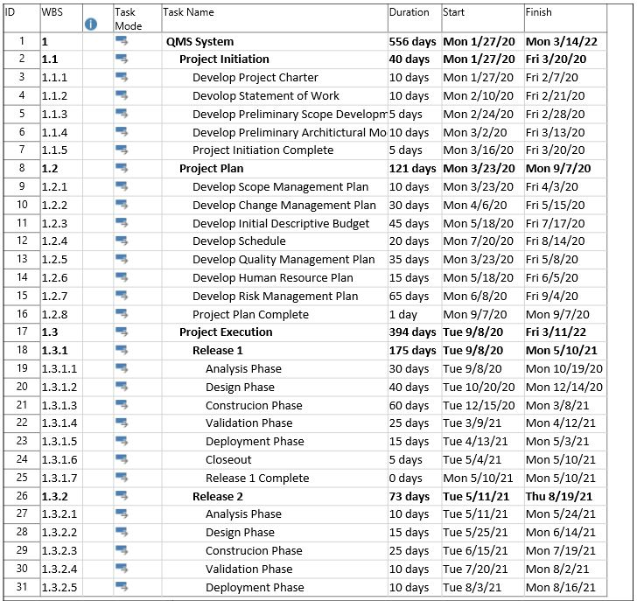
Time Management Time Management Plan
Notes:
(WBS – detailed diagram, identified CPM, project total time + exact start and end dates, Gantt chart)
2-3 Slides

Slide 13
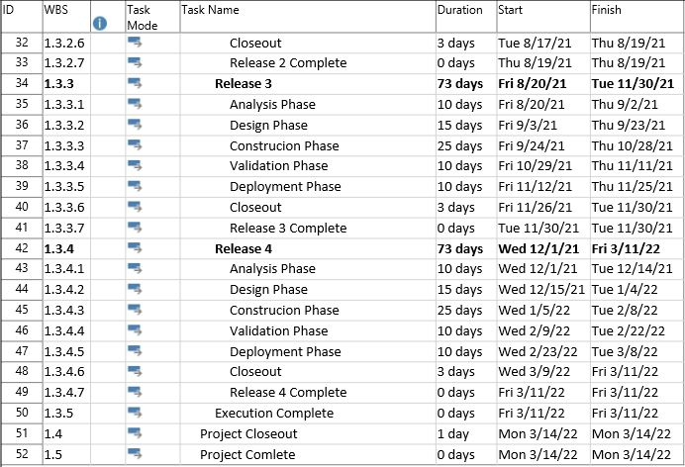
Time Management Time Management Plan – Cont.
Notes:
(WBS – detailed diagram, identified CPM, project total time + exact start and end dates, Gantt chart)
2-3 Slides

Slide 14
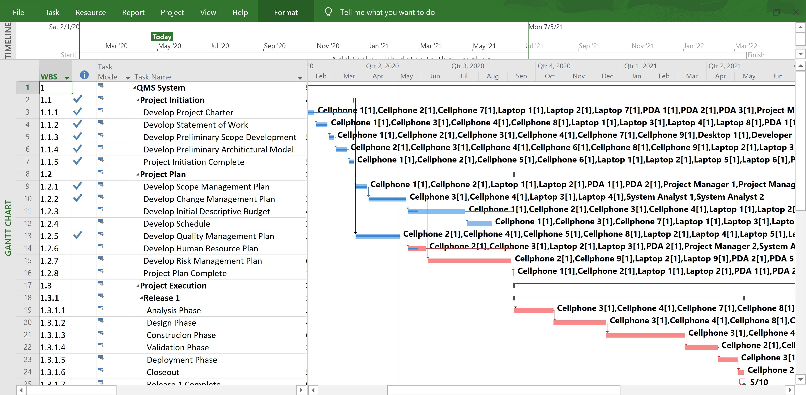
Time Management Gantt Chart

Slide 15
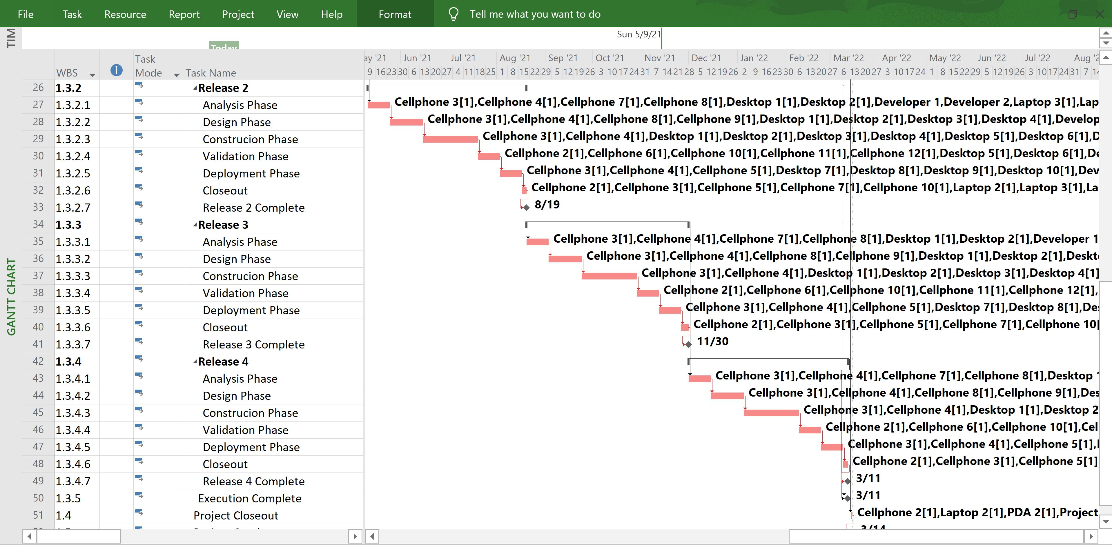
Time Management Gantt Chart – Cont.

Slide 16
Time Management Total Project Time
Phases | Start Date | Final Date | Duration (Days)
1.1 Project Initiation | 1/27/2020 | 3/20/2020 | 40
1.2 Project Plan | 3/23/2020 | 9/7/2020 | 121
1.3.1 Release 1 | 9/8/2020 | 5/10/2021 | 175
1.3.2 Release 2 | 5/11/2021 | 8/19/2021 | 73
1.3.3 Release 3 | 8/20/2021 | 11/30/2021 | 73
1.3.4 Release 4 | 12/1/2021 | 3/11/2022 | 73
Overall Project | 1/27/2020 | 3/14/2022 | 556

Slide 17
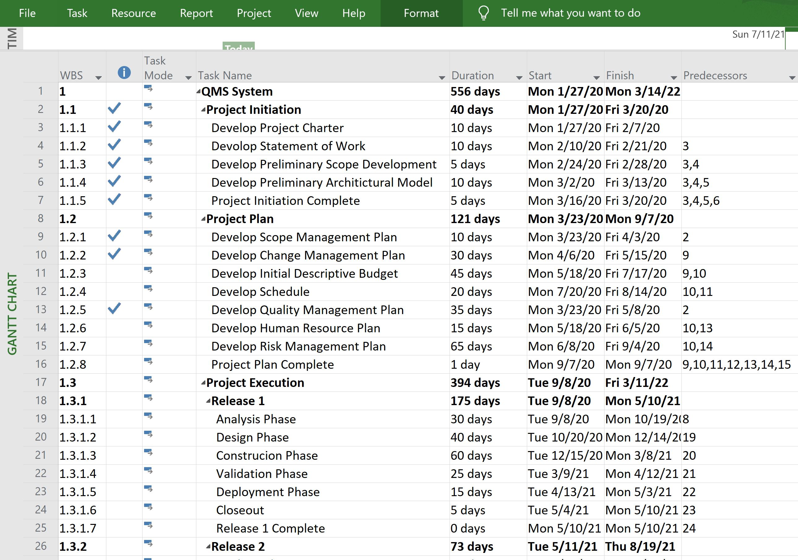
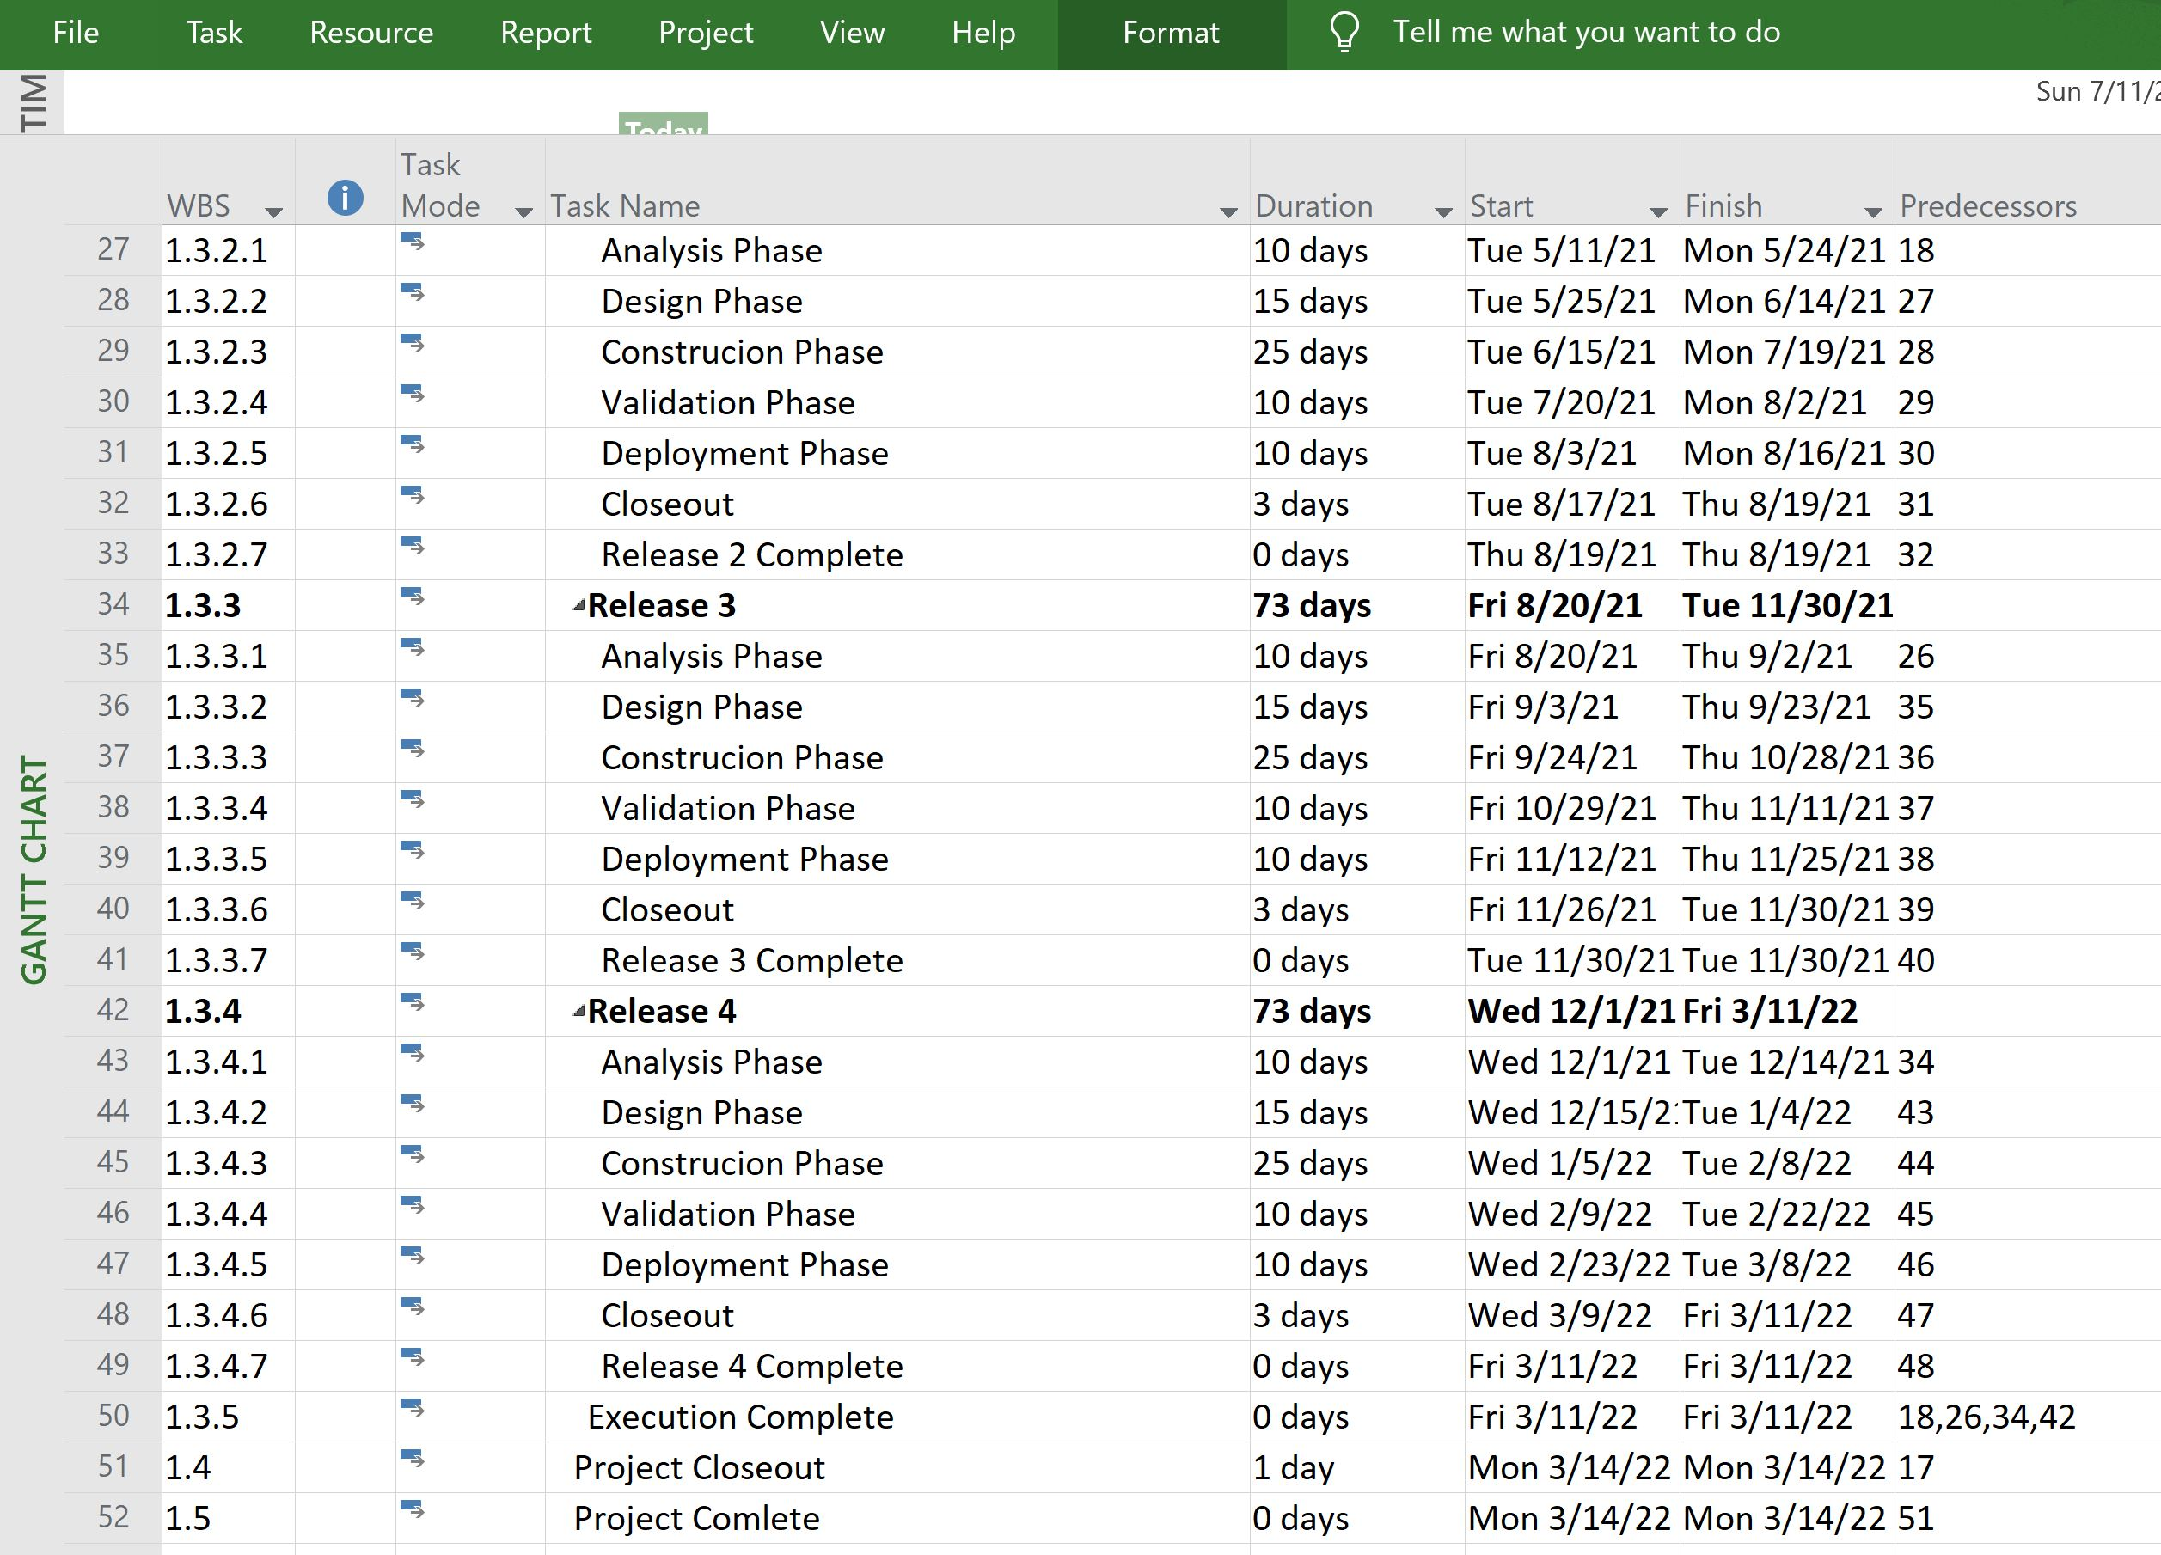
Resource Management WBS Structure
Notes:
(RRM Matrix, types and number of experts involved – their responsibilities + REALISTIC average salaries + experience + hourly rates EXACTLY from BLS.gov or slalry.com or similar websites)
2 Slides

Slide 18
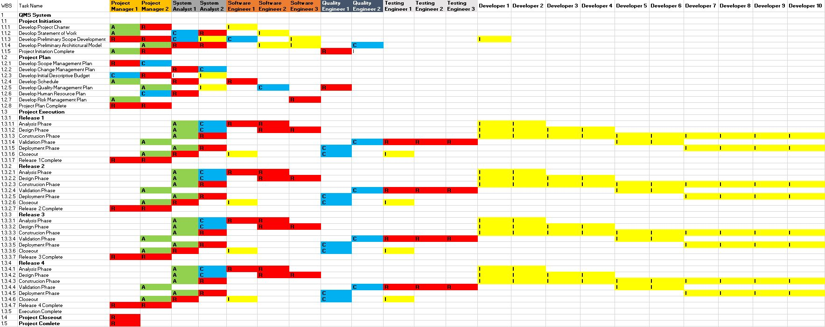
Resource Management Roles and Responsibility Matrix (RRM)
Notes:
(RRM Matrix, types and number of experts involved – their responsibilities + REALISTIC average salaries + experience + hourly rates EXACTLY from BLS.gov or slalry.com or similar websites)
2 Slides

Slide 19
Resource Management Human Resources & Material Resources
Human Resources | Material Resources | Human Resources | Material Resources
Project Manager1 | Laptop1,PDA1,Cellphone1 | Testing Engineer3 | Laptop12, Cellphone12
Project Manager2 | Laptop2,PDA2,Cellphone2 | Developer1 | Desktop1
System Analyst1 | Laptop3,Cellphone3 | Developer2 | Desktop2
System Analyst2 | Laptop4,Cellphone4 | Developer3 | Desktop3
Quality Engineer 1 | Laptop5, Cellphone5 | Developer4 | Desktop4
Quality Engineer 2 | Laptop6, Cellphone6 | Developer5 | Desktop5
Software Engineer1 | Laptop7, Cellphone7, PDA3 | Developer6 | Desktop6
Software Engineer2 | Laptop8, Cellphone8, PDA4 | Developer7 | Desktop7
Software Engineer3 | Laptop9, Cellphone9, PDA5 | Developer8 | Desktop8
Testing Engineer1 | Laptop10, Cellphone10 | Developer9 | Desktop9
Testing Engineer2 | Laptop11, Cellphone11 | Developer10 | Desktop10

Slide 20
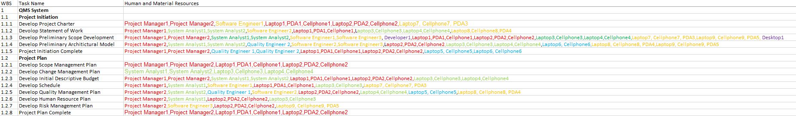
Resource Management Project Phases Resources

Slide 21
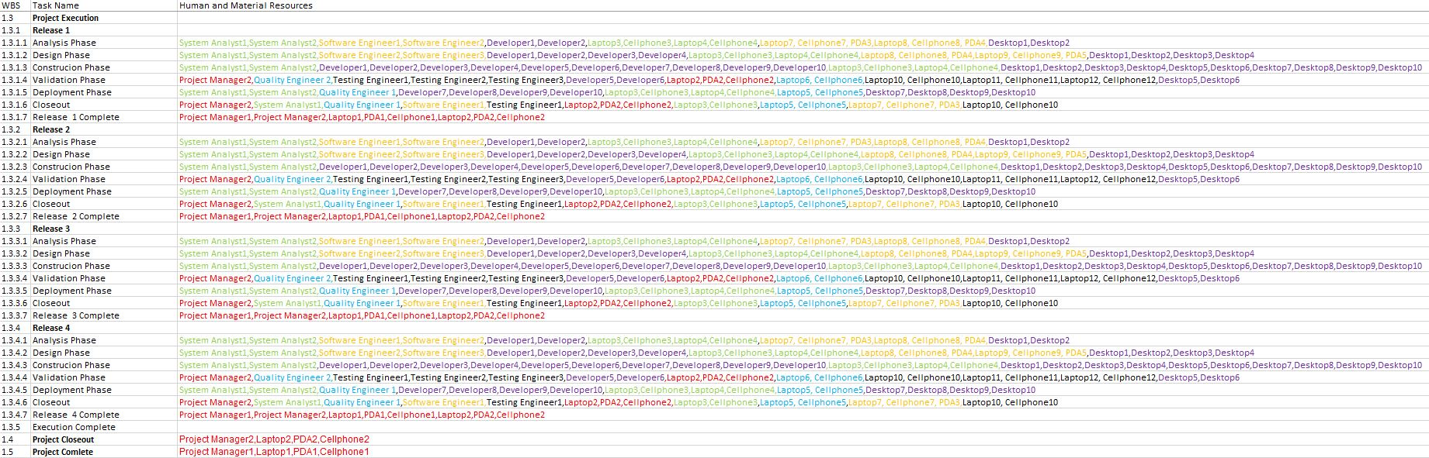
Resource Management Project Phases Resources – Cont.

Slide 22
Resource Management Human Resources
Position | Salary | Experience(Years) | Hourly Rate
Project Manager 1 | $176,000 | 8-10 | $80.00
Project Manager 2 | $146,360 | 5-8 | $66.53
System Analyst 1 | $143,000 | 8-10 | $65.00
System Analyst 2 | $138,600 | 5-8 | $63.00
Quality Engineer 1 | $136,400 | 5-8 | $62.00
Quality Engineer 2 | $111,620 | 3-5 | $50.74
Software Engineer 1 | $132,000 | 8-10 | $60.00
Software Engineer 2 | $110,000 | 5-8 | $50.00
Software Engineer 3 | $103,620 | 3-5 | $47.10
Testing Engineer 1 | $66,000 | 5-8 | $30.00
Testing Engineer 2 | $63,800 | 3-5 | $29.00
Testing Engineer 3 | $63,800 | 3-5 | $29.00
Developer 1 | $121,000 | 5-8 | $55.00
Developer 2 | $121,000 | 5-8 | $55.00
Developer 3 | $83,600 | 3-5 | $38.00
Developer 4 | $83,600 | 3-5 | $38.00
Developer 5 | $83,600 | 3-5 | $38.00
Developer 6 | $83,600 | 3-5 | $38.00
Developer 7 | $83,600 | 3-5 | $38.00
Developer 8 | $83,600 | 3-5 | $38.00
Developer 9 | $83,600 | 3-5 | $38.00
Developer 10 | $83,600 | 3-5 | $38.00
Notes:
A table of main project required materials + REALISTIC cost of each material
1 Slide

Slide 23
Resource Management Material Resources
Material Resources | Price | Material Resources | Price
Laptop 1 | $1,961.99 | Cellphone 9 | $763.00
Laptop 2 | $1,885.69 | Cellphone 10 | $763.00
Laptop 3 | $1,885.69 | Cellphone 11 | $654.00
Laptop 4 | $1,743.99 | Cellphone 12 | $654.00
Laptop 5 | $1,743.99 | PDA 1 | $653.99
Laptop 6 | $1,743.99 | PDA 2 | $435.99
Laptop 7 | $1,634.99 | PDA 3 | $435.99
Laptop 8 | $1,634.99 | PDA 4 | $217,99
Laptop 9 | $1,416.99 | PDA 5 | $217,99
Laptop 10 | $1,416.99 | Desktop 1 | $2,397.99
Laptop 11 | $1,416.99 | Desktop 2 | $2,397.99
Laptop 12 | $1,362.49 | Desktop 3 | $1,664.60
Cellphone 1 | $1,098.00 | Desktop 4 | $1,664.60
Cellphone 2 | $981,00 | Desktop 5 | $1,664.60
Cellphone 3 | $872.00 | Desktop 6 | $1,664.60
Cellphone 4 | $872.00 | Desktop 7 | $1,504.19
Cellphone 5 | $872.00 | Desktop 8 | $1,504.19
Cellphone 6 | $872.00 | Desktop 9 | $1,504.19
Cellphone 7 | $872.00 | Desktop 10 | $1,504.19
Cellphone 8 | $763.00
Notes:
A table of main project required materials + REALISTIC cost of each material
1 Slide

Slide 24
Cost Management

Slide 25
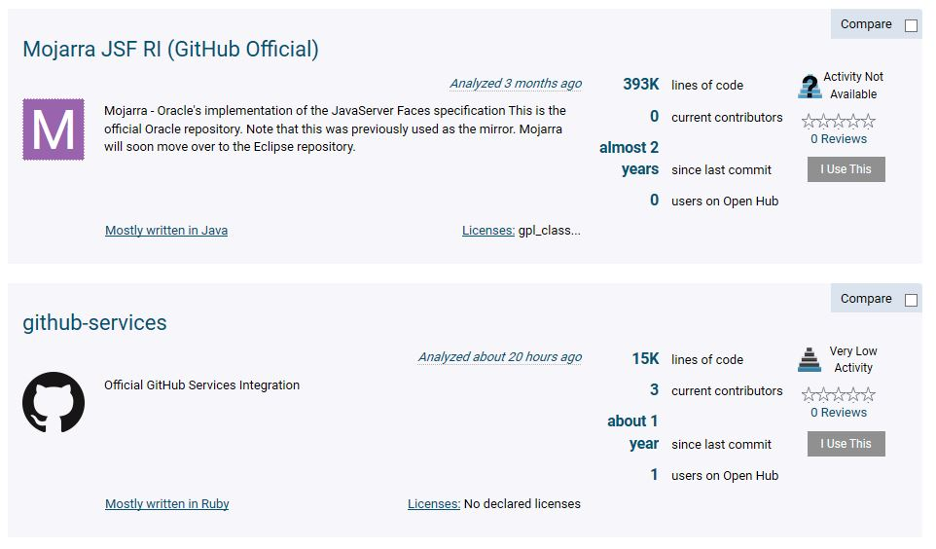
Project Cost Estimates LOC Based Estimation

Slide 26
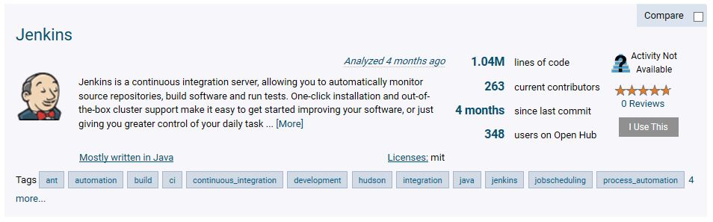
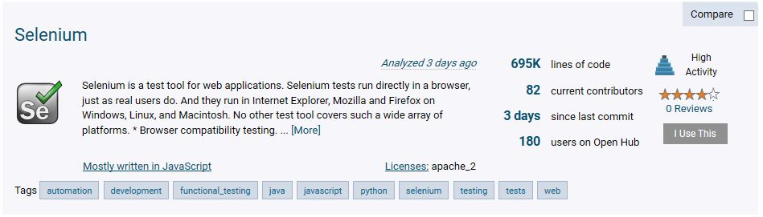
LOC Based Estimation

Slide 27
LOC Based Estimate
LOC Based Estimation
Function | Pages | Lines of Code per page | Total Lines Of Code
User Interfaces for Static Pages | 170 | 110 | 18700
User Interface for Dynamic Pages | 195 | 158 | 30810
Code behind Static Pages | 180 | 135 | 24300
Code behind Dynamic Pages | 240 | 165 | 39600
DataBase- SQL Stored Procedures | 34 | 95 | 3230
Busines Layer Logical Pages | 84 | 134 | 11256
Other Layer Logical Pages | 28 | 70 | 1960
 |  | Total | 129856
 |  | Total Project Cost | $2,077,696.00
$16 per line of code

Slide 28
Functional Point Analysis
Complexity Calculation
Category | Low | Weight_L | Average | Weight_A | High | Weight_H | Total(T)
User Inputs | 13 | 3 | 15 | 6 | 3 | 7 | 150
User Outputs | 18 | 5 | 21 | 6 | 4 | 9 | 252
User Inquiries | 28 | 7 | 23 | 6 | 14 | 6 | 418
File/Structures | 21 | 11 | 14 | 12 | 4 | 15 | 459
External Interfaces | 25 | 10 | 14 | 9 | 8 | 11 | 464
Unadjusted Total(UT): |  |  |  |  |  |  | 1743
Cost per Function Point |  |  |  |  |  |  | 1220
Total |  |  |  |  |  |  | $2,126,460.00

Slide 29
Cost Management -list of project human resources (with salaries);
Resource Name | Type | Initials | Std. Rate
Project Manager 1 | Work | P | $80.00/hr
Project Manager 2 | Work | P | $66.53/hr
System Analyst 1 | Work | S | $65.00/hr
System Analyst 2 | Work | S | $63.00/hr
Quality Engineer 1 | Work | Q | $62.00/hr
Qulaity Engineer 2 | Work | Q | $50.74/hr
Software Engineer 1 | Work | S | $60.00/hr
Software Engineer 2 | Work | S | $50.00/hr
Software Engineer 3 | Work | S | $47.10/hr
Testing Engineer 1 | Work | T | $30.00/hr
Testing Engineer 2 | Work | T | $29.00/hr
Testing Engineer 3 | Work | T | $29.00/hr
Developer 1 | Work | D | $55.00/hr
Developer 2 | Work | D | $55.00/hr
Developer 3 | Work | D | $38.00/hr
Developer 4 | Work | D | $38.00/hr
Developer 5 | Work | D | $38.00/hr
Developer 6 | Work | D | $38.00/hr
Developer 7 | Work | D | $38.00/hr
Developer 8 | Work | D | $38.00/hr
Developer 9 | Work | D | $38.00/hr
Developer 10 | Work | D | $38.00/hr
Notes:
Project Budget report (like a report from MS Project at the end of Lab_02 + total project budget + project budget for main phase of your project)
2 Slides

Slide 30
Cost Management -list of project materials (with costs)
Material Resources | Price | Material Resources | Price
Laptop 1 | $1,961.99 | Cellphone 9 | $763.00
Laptop 2 | $1,885.69 | Cellphone 10 | $763.00
Laptop 3 | $1,885.69 | Cellphone 11 | $654.00
Laptop 4 | $1,743.99 | Cellphone 12 | $654.00
Laptop 5 | $1,743.99 | PDA 1 | $653.99
Laptop 6 | $1,743.99 | PDA 2 | $435.99
Laptop 7 | $1,634.99 | PDA 3 | $435.99
Laptop 8 | $1,634.99 | PDA 4 | $217,99
Laptop 9 | $1,416.99 | PDA 5 | $217,99
Laptop 10 | $1,416.99 | Desktop 1 | $2,397.99
Laptop 11 | $1,416.99 | Desktop 2 | $2,397.99
Laptop 12 | $1,362.49 | Desktop 3 | $1,664.60
Cellphone 1 | $1,098.00 | Desktop 4 | $1,664.60
Cellphone 2 | $981,00 | Desktop 5 | $1,664.60
Cellphone 3 | $872.00 | Desktop 6 | $1,664.60
Cellphone 4 | $872.00 | Desktop 7 | $1,504.19
Cellphone 5 | $872.00 | Desktop 8 | $1,504.19
Cellphone 6 | $872.00 | Desktop 9 | $1,504.19
Cellphone 7 | $872.00 | Desktop 10 | $1,504.19
Cellphone 8 | $763.00

Slide 31
Cost Management -project budget (partial outcome of Lab # 2)
Phases | Total Project Cost($) | Actual Cost($) | Remaining Cost($)
Project Initiation | $162,735.52 | $162,735.52 | $0.00
Project Plan | $286,971.5 | $123,336.92 | $163,634.58
Release 1 | $684,274.56 | $0.00 | $684,274.56
Release 2 | $342,645.68 | $0.00 | $342,645.68
Release 3 | $342,645.68 | $0.00 | $342,645.68
Release 4 | $342,645.68 | $0.00 | $342,645.68
Overall Project | $2,165,753.54 | $286,072.44 | $1,879,681.10

Slide 32
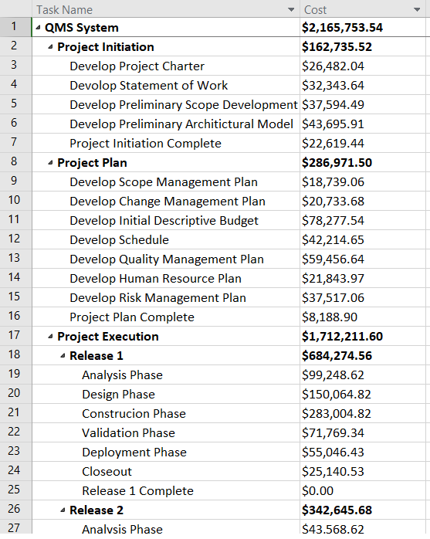
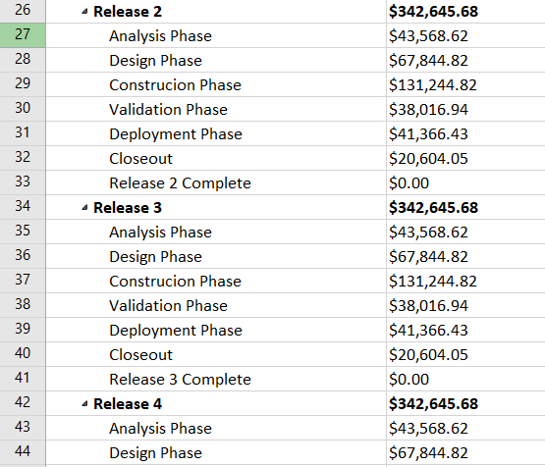
Cost Management -Project Budget(Partial Outcome of Microsoft Project)

Slide 33
Risk Management-Decision Tree analysis with EMV
Probability | Original Cost | Outcome | Final Cost(Probability* Outcome)
CF(.25) | $2,165,753.54 | $86,371.24 | $21,592.81
PS(.1) | $2,165,753.54 | $1,362,282.64 | $136,228.26
CS(.65) | $2,165,753.54 | $2,165,753.54 | $1,407,739.80
 |  | Total | $1,565,560.88
CF(.4) | $2,165,753.54 | $35,056.86 | $14,022.74
CS(.6) | $2,165,753.54 | $2,165,753.54 | $1,299,452.12
 |  | Total | $1,313,474.87
.25
In-house
Development
CF
.1
PS
Software
CS
.65
Outsource
CF
.4
CS
.6
Notes:
Decision Tree with EMV for In-House and Outsourcing with various options and probabilities and well thought outcomes (costs of each option)
1 Slides

Slide 34
Risk Management -Risk List (with at least 7 different types of risks associated with this project)
Types of Risks | Key | Explanation
Integration Management | Integration points | Avoiding extreme complexity by smart and simple planning will result in a better integration.
Scope Management | Change in requirements | Frequent changes to the requirements can cause serious damage to the project.
Time Management | Unrealistic schedules | Setting unrealistic schedules is a sign of poor management and can cause unwanted and very expensive delays.
Cost Management | Unproven technology | The use of unproven technologies might prove more problematic than beneficial.
Quality Management | Testing plans | Testing can be performed often to insure the early discovery of problems.
Human Resource Management | Experience and knowledge | Staff need to have knowledge and experience and be provided with proper training to work in a QMS project.
Communication Management | Lack of communication or miscommunication | All parties involved in the project need to communicate and provide feedback to guarantee the success of the project.
Procurement Management | Change in staff | Any changes in the staff (Project managers, System analysts, Software engineers, Quality Engineers, Testing engineers) will complicate the completion of the project.
Notes:
(a list of risks relevant to your project, risk exposure, Risk Impact-Probability matrix – OPTIONAL, Risk Register)
2 Slides

Slide 35
Risk Management-Risk Impact and probability
S.N0 | Risk | Impact | Probability
1 | Cost management | Medium | Medium low
2 | Requirement Analysis | Medium Low | Low
3 | Beginners on the project | High | High
4 | Using APIs or Third party Used | Medium High | Medium High
5 | Acquiring New System | Low | Medium
6 | Using the Offshore Resources | Medium | High
7 | Knowledge Transfer on New Transfer | Medium High | High

Slide 36
Risk Management -Risk Exposure table
Risk No. | Risk Drivers | Risk Probability (RP) | Risk Impact (RI) | Risk Exposure (RP * RI)
1 | Experience and Teaming | Medium (0.5) | Medium (0.5) | 0.25
2 | Requirements and Design | Medium (0.5) | Medium High (0.7) | 0.35
3 | Planning | Medium Low (0.3) | Medium Low (0.3) | 0.09
4 | Testing | Medium (0.5) | Medium High(0.7) | 0.35
5 | Tools | Low (0.1) | Medium Low (0.3) | 0.03
6 | Schedule | Medium High (0.7) | Medium Low (0.3) | 0.21
 | Total Risk Adjustment Factor |  |  | 1.28

Slide 37
Risk Management- Probability Impact Matrix
 | Low | Low Medium | Medium | Medium High | High
Low
Medium Low | 5 | 3 |  | 6
Medium |  |  | 1
Medium High |  |  | 2,4
High |  |  |  | 7
Impact
Probability

Slide 38
Risk Management -Lab 03 Outcomes
Case # | Project Total Cost | Risk Factor | Duration(Days) | Probability | Expected Value
0 | $2,165,753.54 | 1.62 | 556 days
1(Remove 1 expert) | $2,150,755.59 | 1.9 | 568.2 days | Partial Failure(35%) | ($5,249.28)
2(Remove 2 Experts) | $2,135,589.87 | 2.2 | 580.47 days | Complete Failure(30%) | ($9,049.10)
3(add 2 Expert) | $2,165,777.26 | 0.94 | 540.55 days | Complete Success(15%) | $3.56
4(Add 4 beginners) | $2,172,957.33 | 1.28 | 535.97 days | Partial Success(20%) | $1,440.76
 |  |  |  | EMV | ($12,854.07)
 |  |  |  | Total EMV | $2,152,899.47

Slide 39
Risk Management -Project Prioritized Risks diagram

Slide 40
Risk Management -Project Prioritized Risks diagram Part 2

Slide 41
Procurement Management-Make or Buy Diagram
Simple 0.3
Simple | 0.3 |  |  | $2,165,753.54 | $649,726.06
Difficult | 0.7 |  |  | $2,500,753.54 | $1,750,527.48
 |  |  |  | Total | $2,400,253.54
Minor Changes | 0.4 |  | 1 | $550,753.54 | $220,301.42
Major Changes | 0.6 | Simple | 0.2 | $780,753.54 | $156,150.71
 | 0.6 | Complex | 0.8 | $980,753.54 | $784,602.83
 |  |  |  | Total | $1,161,054.96
Minor Changes | 0.7 |  |  | $2,350,753.54 | $1,645,527.48
Major Changes | 0.3 |  |  | $2,420,753.54 | $726,226.06
 |  |  |  | Total | $2,371,753.54
Without Changes | 0.6 |  |  | $2,380,753.54 | $1,428,452.12
With Changes | 0.4 |  |  | $2,580,753.54 | $1,032,301.42
 |  |  |  | Total | $2,460,753.54
Difficult 0.7
Build
Minor Changes 0.4
Simple 0.2
Re-Use
Major. 0.6
Changes
Complex 0.8
SQA System
Minor changes 0.7
Buy
Major Changes 0.3
Contract
Without Changes 0.6
With Changes 0.4
Notes:
(Make-Buy Diagram, type of Contract to be used + justification)
2 Slides

Slide 42
Procurement Management- Contract to be used—Using CPIF
Case 1 |  |  | Case 2
Sharing Formula : 85/15, 85% by buyer and 15% by seller |  |  | Sharing Formula :85/15, 85% by buyer and 15% by seller
Allowable cost: $2,050,500.5 |  |  | Allowable cost :$2,050,500.5
Target Fee: $150,000 |  |  | Target Fee :$150,000
Maximum Fee :$180,000 |  |  | Maximum Fee :$180,000
Minimum Fee :$90,000 |  |  | Minimum Fee :$90,000
Project Result: |  |  | Project Result:
Seller completes the project at cost of $1,850,753.54 |  |  | Seller completes the project at cost of $2200,753.54
seller is paid $1,850,753.54+($2,050,500.5-$1,850,743.54)*.15 + $150,000= $2,030,717.84 |  |  | seller is paid: $2,050,500.5 + $90,000=$2140,500.5
seller profit= $2,030,717.84-$1,850,753.54 = $179,964.3 |  |  | seller profit= $90,000

Slide 43
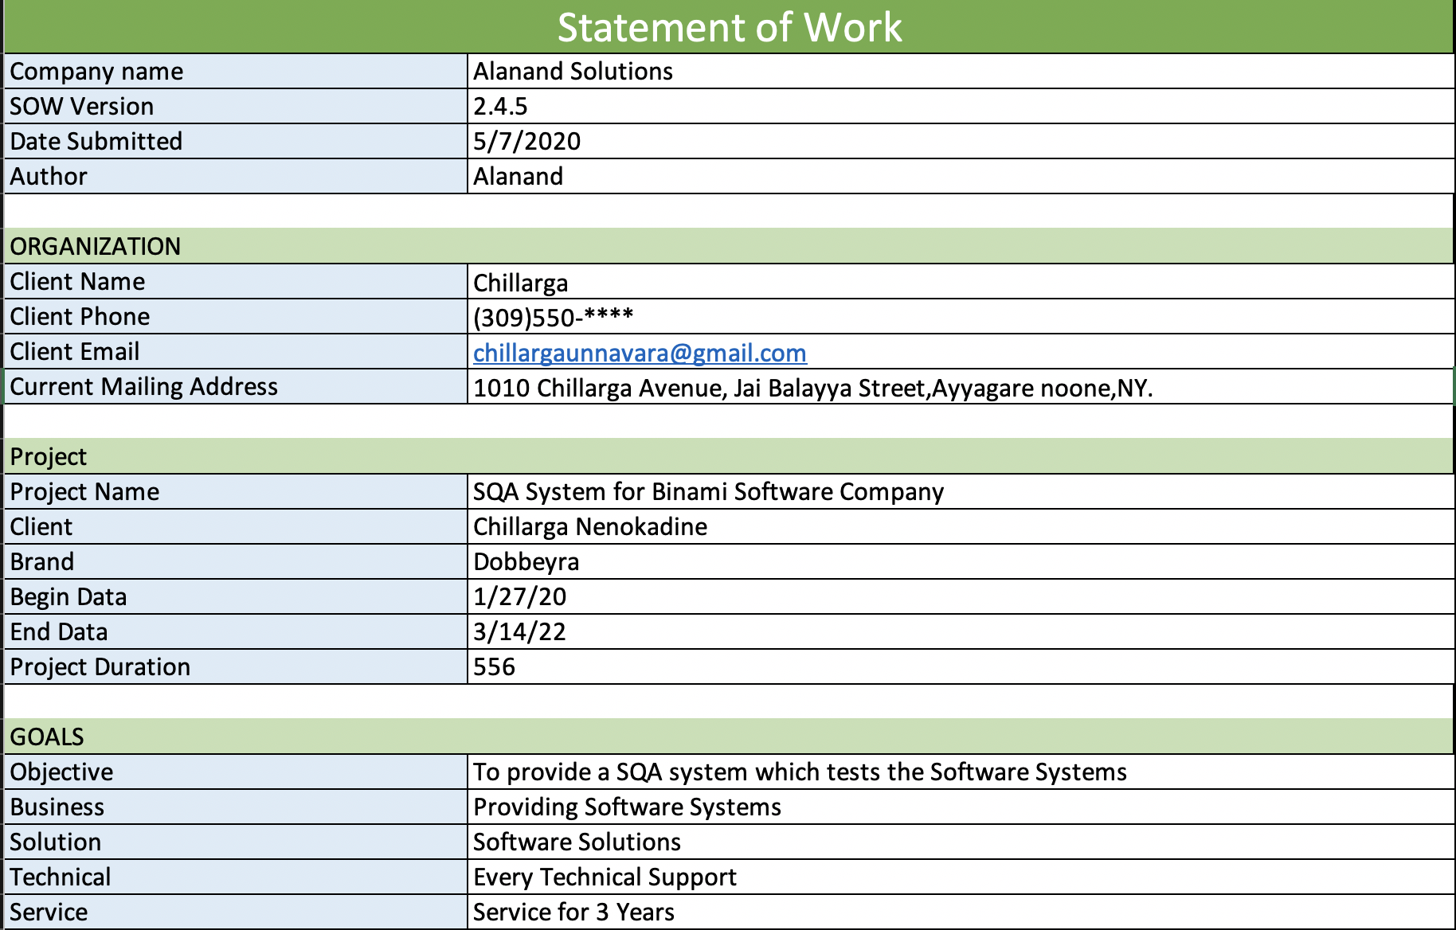
Statement of Work- Part1
Notes:
(a very “dry”, concise and precise document) (project goal, objectives, scope of work – requirements and constraints, names of key stakeholders, assumptions – if any, critical success factors, duration - time period, budget, location, team organization, main risks, conditions of SW or CIS system’s acceptance, type of contract to be used, and other most important items).
1 Slide

Slide 44
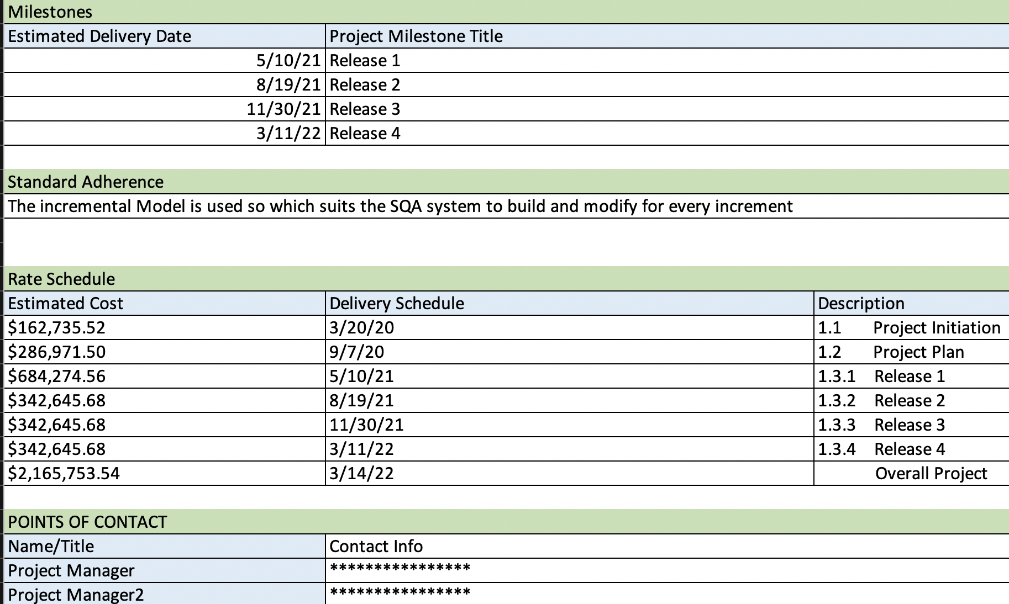
Statement Of Work- Part 2

Slide 45
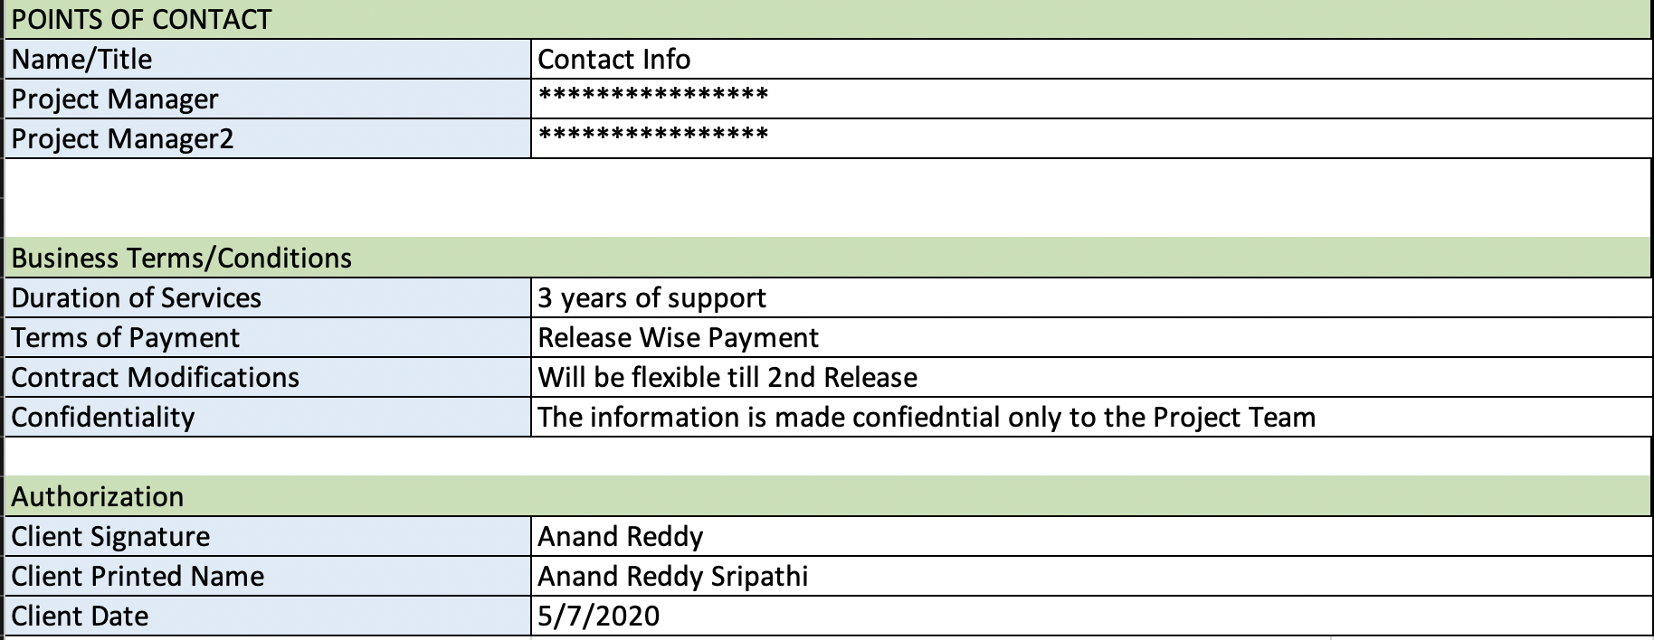
Statement Of Work – Part3

Slide 46


References:
[1] | https://the9000store.com/iso-9001-2015-requirements/what-is-iso-9001-quality-management-system/
[2] | https://quality.eqms.co.uk/blog/types-of-quality-management-systems
[3] | https://qa-platforms.com/software-quality-management-sqm/
[4] | https://metadesignsolutions.com/differences-between-SQA-and-SQC
[5] | https://fortegrp.com/11-popular-software-testing-tools/
[6] | https://www.guru99.com/hp-alm-introduction.html
[7] | https://www.gurock.com/testrail
[8] | https://www.microfocus.com/en-us/products/quality-center-quality-management/download
[9] | https://www.gurock.com/testrail/
[10] | https://www.selenium.dev/
[11] | https://jenkins.io/
[12] | https://newrelic.com/
[13] | https://www.oracle.com/corporate/acquisitions/wercker/
[14] | https://github.com/
[15] | https://github.com/tmux/tmux/wiki
[16] | https://www.postman.com/
[17] | https://www.testing-whiz.com/
[18] | https://sahipro.com/
[19] | https://www.ranorex.com/
[20] | https://www.mastercontrol.com/quality/qms/requirements

Slide 47

THANK YOU

